Slide 1
Inventory Management System

Slide 2
Introduction
I am Omar O’dare Abu-Tair I am a former undergraduate in software engineering.
I approached the specification while considering the weeks that we have completed thus far which meant that I had to begin by gathering the requirements and from their begin creating a Jira board detailing the steps you need to meet the specification. From there I designed the database and began to work on programming. Whilst occasionally returning to the specification so that the project is meeting it.
During the course of this project I have used many technologies, Git for version control and source code management. For the purpose of planning our Kanban board I used Jira. For the creation of the data base we used MYSQL and more specifically workbench to create the schema and run the scripts. My project is also a Maven project which is its build tool and for testing I utilised Junit testing with Mockito.

Slide 3
CI – Version controll
I began by creating different feature branches that branched from dev, I would occasionally push my progress for each feature to git. The idea was that I would create a branch for each new feature I would implement. Merging the feature branches into dev and then finally merging dev into main with all the features
This would have ideally allowed me to separate working and developing branches from each other so that I would have working versions available and would allow me to return to a version of my application that may have worked better or a feature may not have been implemented correctly and is causing issues with other classes which would allow you to better understand where the error began as doing big pushes that don’t work would need a lot of debugging to understand what went wrong.

Slide 4

Testing
I used Junit testing and Mockito and the classes that were tested were the domain classes, controller classes and DAO classes and I was only able to get up to the following coverage. Unfortunately I wasn’t able to achieve the required 80%.
I used my own SQL data and schema to the test which will initialize and check the tests against it.

Slide 5
Demonstration
Item CRUD
Order CRUD

Slide 6
Sprint Review and retrospective
The Jira board wasn’t as in depth as I would have liked it to be due to time constraints and last minute changes however the sprint goals I set out were completed. However there were more that I didn’t add to the board but were otherwise implemented such as getting order basket total for items in an order below is just a screenshot of my jira during points of development.
There were some features that I didn’t implement in the way I liked and others I didn’t implement at all. I wanted to show items in an order however due to time constraints these features were left behind. And adding items to an order was done through updating an already existing order instead of being separated as its own menu.

Slide 7
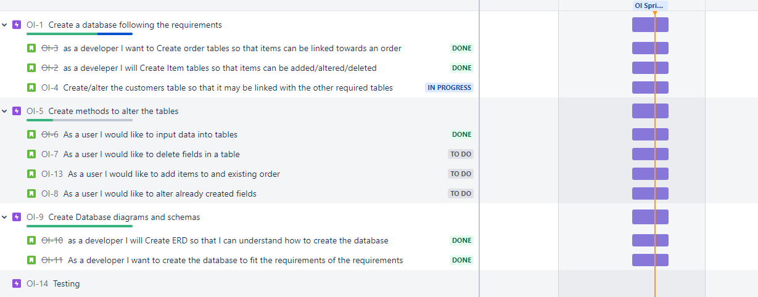
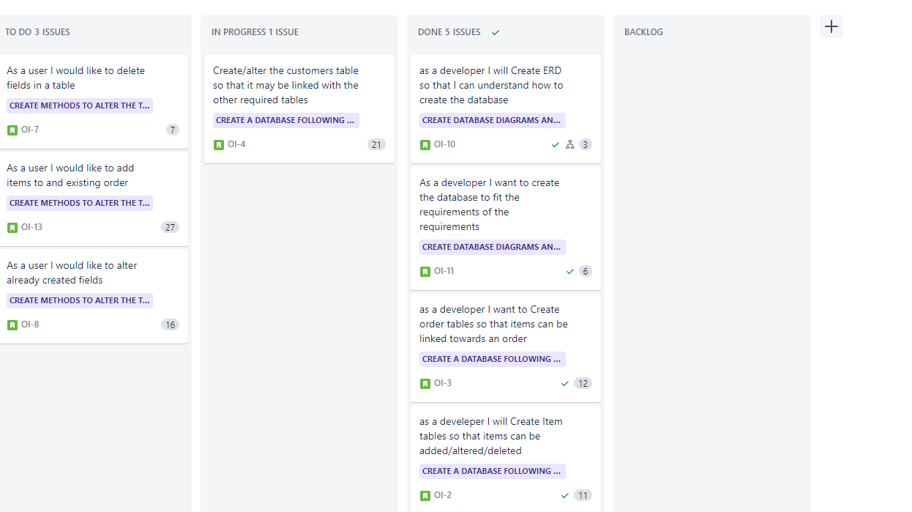
Jira

Slide 8
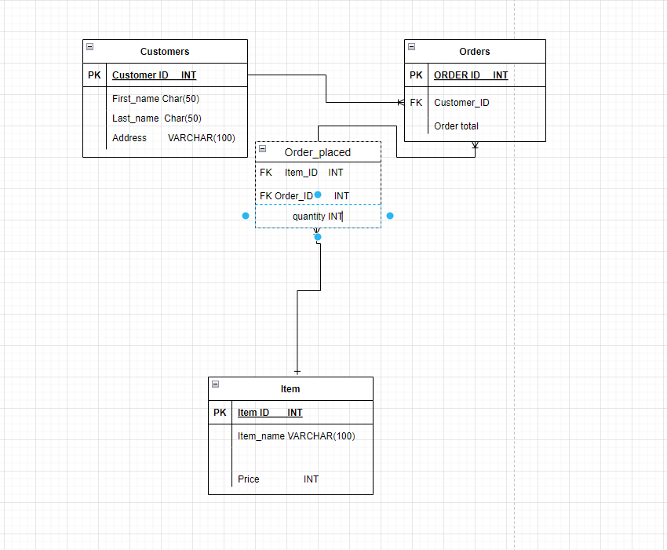
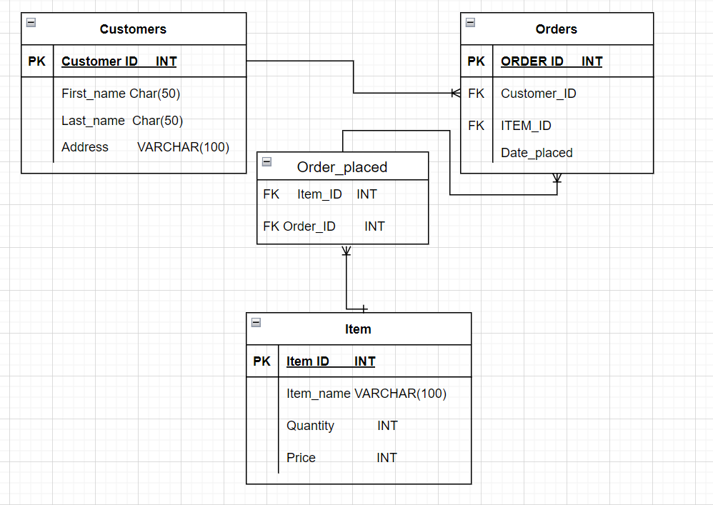
Conclusion
In conclusion I believe I did quite ok considering the time considering the short span in which we were required to complete this. I believe having to do a lot of tasks in parallel of each other was more difficult then I anticipated. I think there was a lot of juggling required for this project that I found very stressful. I believe it was good practice for future development in terms of how I would better spend my time.
To the left is Initial design and to the right the newer one.

